Slide 1
Spelling and Grammar W/C- 6/07/2020 Words that end in the sound /shuhn/.

Slide 2
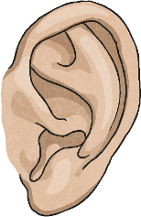
This week, we are going to look again at words that end in the sound /shuhn/.
This time, the words we are learning to spell are all going to use ‘tion’ to make the sound.
Working with a partner, you are going to sort your spelling words into a table by thinking about the root words used before the ‘tion’ suffix is added.
But first, can you guess your spelling words for this week by reading their definitions?
Remember, they’ll all have ‘tion’ endings.

Slide 3
Can you guess your spelling words for this week by reading their definitions?
A sentence or phrase used to find out information.
?

Slide 4
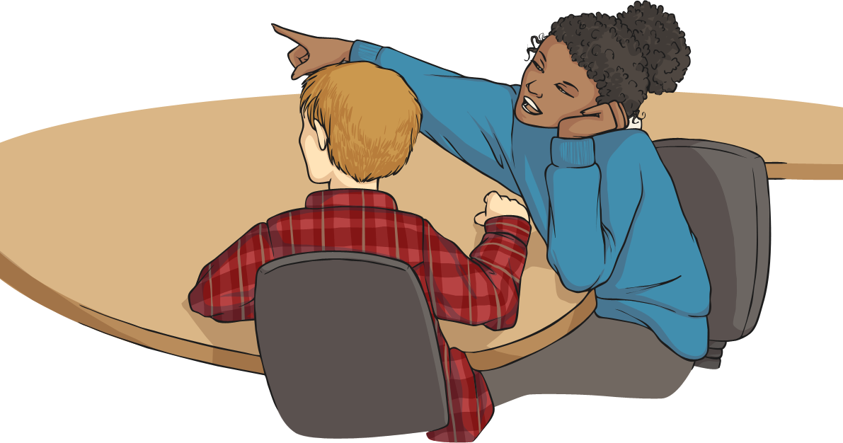
Can you guess your spelling words for this week by reading their definitions?
To speak about something quickly without much detail.

Slide 5
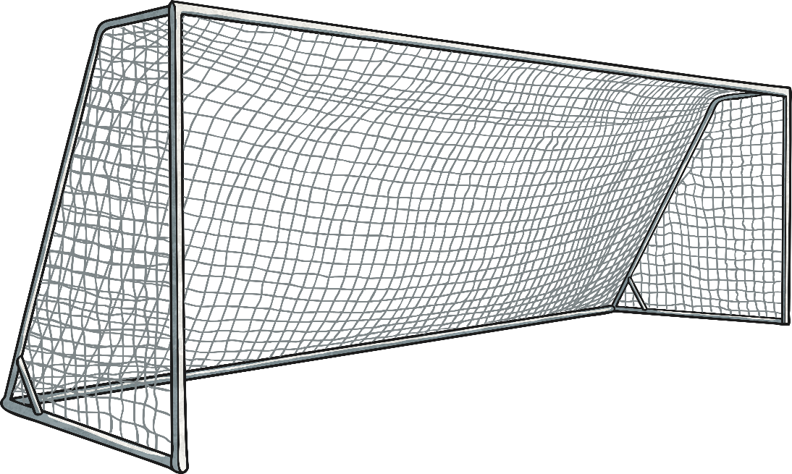
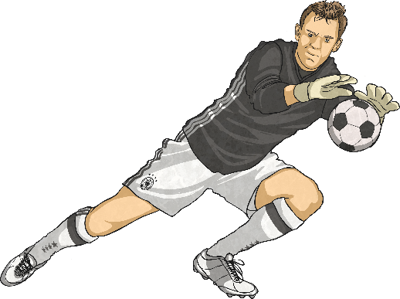
Can you guess your spelling words for this week by reading their definitions?
A place where someone or something is located.

Slide 6
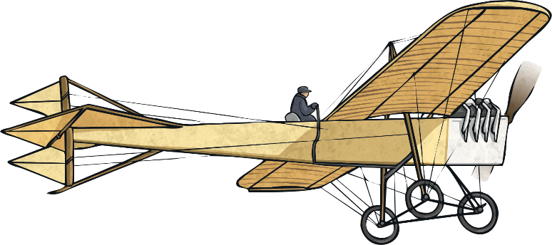
Can you guess your spelling words for this week by reading their definitions?
Something that has never been made before.

Slide 7
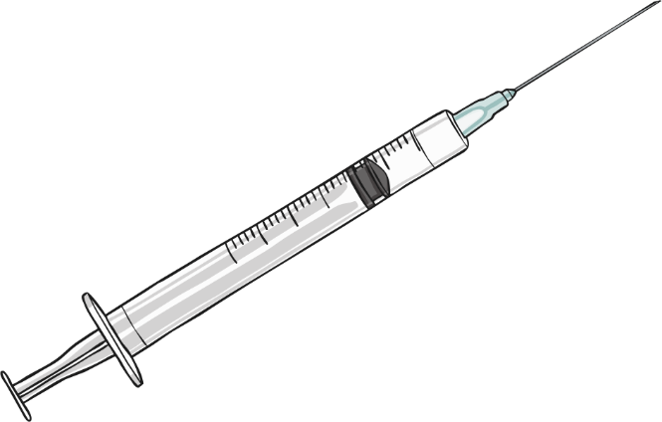
Can you guess your spelling words for this week by reading their definitions?
The act of putting a liquid medicine into a person's body using a needle and a syringe.

Slide 8
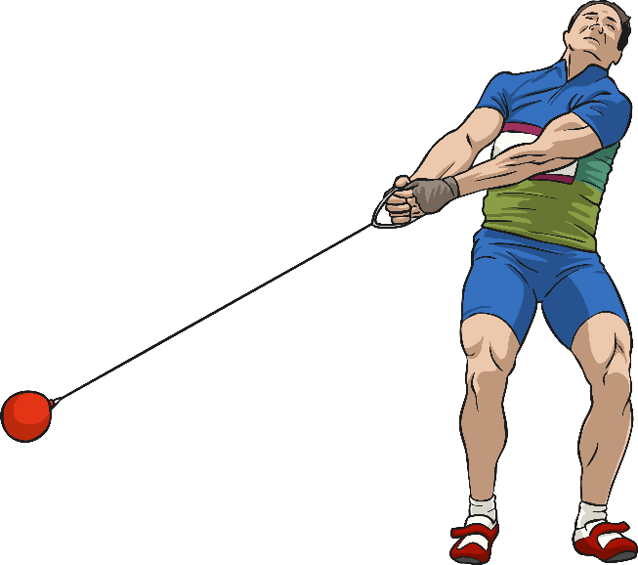
Can you guess your spelling words for this week by reading their definitions?
The process of doing something to achieve an aim.

Slide 9
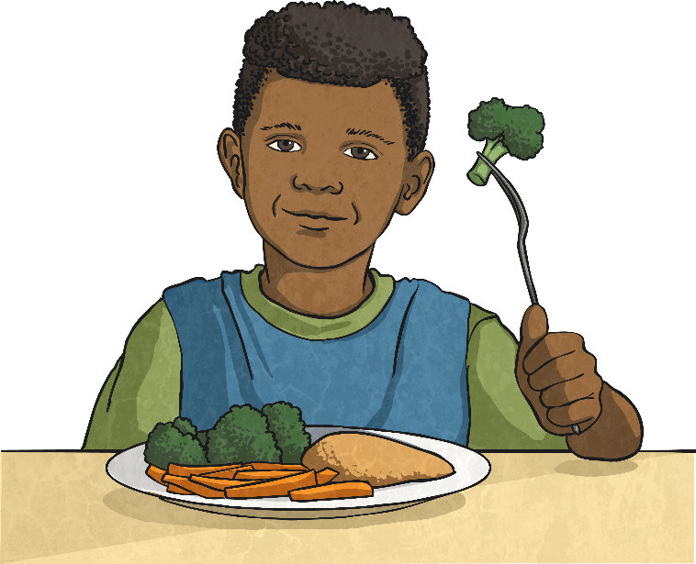
Can you guess your spelling words for this week by reading their definitions?
A strong liking for someone or something.

Slide 10
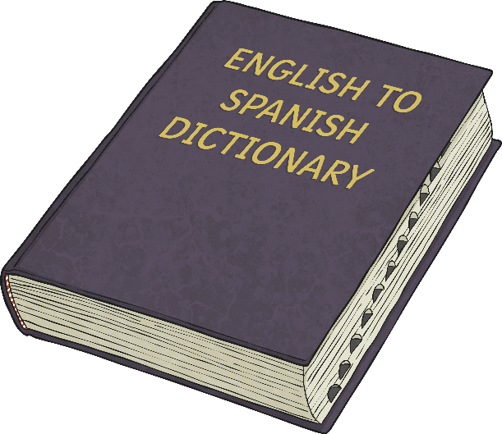
Can you guess your spelling words for this week by reading their definitions?
The process of changing words or text from one language into another.

Slide 11
Can you guess your spelling words for this week by reading their definitions?
A feeling of strong loyalty, love of care of someone or something.

Slide 12
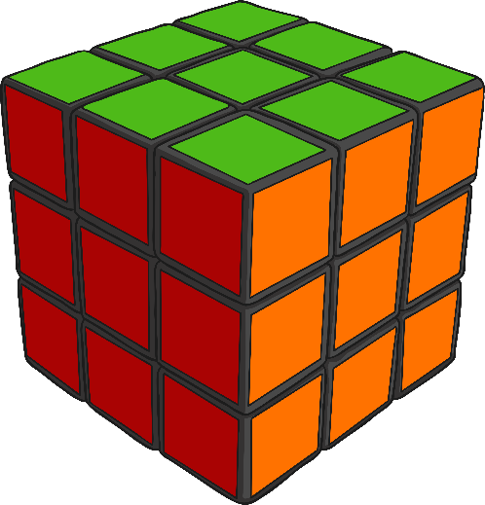
Can you guess your spelling words for this week by reading their definitions?
The answer to a problem or how to deal with a difficult situation.

Slide 13
Answers
question
mention
position
invention
injection
action
attraction
translation
devotion
solution

Slide 14
Activity 2

Slide 15
Look at these –tion words with a partner. Think about their root words.
Can you sort them into a table?
No definite root word | Root word ends in ‘t’ | Root word end in ‘te’
injection
mention
action
question
position
translation
attraction
solution
devotion
invention

Slide 16
Answers

Slide 17
So what happens to the root words that end in ‘te’ when –tion is added?
Root word end in ‘te’
translation
devotion
solution
translate + tion = translation
devote + tion = devotion
solute + tion = solution
The ‘e’ isn’t needed! Can you think of anymore words that could fit into this section of your table?

Slide 19
Activity 3

Slide 22
Activity 4

Slide 23
First

Slide 24
Then

Slide 25
Activity 5
If you can take a
Spelling Test
or
Look Cover Write

Slide 28
Grammar Work and Mats

Slide 29
Grammar – To write expanded noun phrases
Using the links complete the activities and games.
Choose which activities you wish to complete or have a go at them all.
https://www.bbc.co.uk/bitesize/articles/znpbgwx

