Slide 1

Welcome to Abacus!
6pm to 6.30pm - Please feel free to sample our school dinners and visit the Foundation classrooms
6.30pm to 7pm – New Intake presentation

Slide 2
Welcome to Abacus!
To introduce the Foundation team
To let you know how to prepare your child for school
To discuss the day to day running of Foundation
To share transition arrangements

Slide 3

OUR TEAM
Mrs Borley & Mrs Smith – Blue Class Teachers
Mrs South – Pink Class Teacher
Cover Teacher – same person every week
Mrs Renshaw– Blue Class LSA
Ms Fryer – Pink Class LSA

Slide 4

Starting school
Your child is ready for school if they can…
Recognise their name – hear it and see it (no expectation to be able to write it!)
Getting dressed/undressed independently – jumper/cardigan
Recognise their coat and put it on independently
Put their shoes on independently – Velcro, no laces
Go to the toilet and wash their hands independently
Sit still on the floor with their legs crossed for a short period of time
Have good manners - know when to say please, thank you and sorry
Be able to tidy up after themselves – putting toys away, tucking their chair in etc
Take turns and share with other children
Be able to tolerate delay/be aware of other’s needs
https://www.familylives.org.uk/advice/primary/learning-school/starting-primary-school

Slide 5
A day in the life…
8:45 - Register and Early Morning Work
9:00 - Phonics
9:30 – English (Free Play & Snack)
10:45 - Playtime
11:00 – Maths (Free Play)
11:35 – Singing and poem of the day
11:45 - Lunchtime
12:45 - Register
12:50 - Phonics
13:15 - Topic work / PE
14:45 – Reading – individual and whole class
15:15 - Hometime

Slide 6
Lunch
  The children get an hour for lunch: 11:45 – 12:45
  Free school meals for all children
  Red – meat option
  Green – vegetarian option
  Yellow – jacket potato (cheese/beans/tuna)
  Purple – roll/baguette
  Allergies/dietary needs can be met – arrange a meeting to discuss/can discuss at home visit
  Talk to your child in the morning about the choices and help them make a good choice ☺
  Healthy and Nut Free School – packed lunches need to reflect this
  Limited time – don’t over pack!

Slide 7

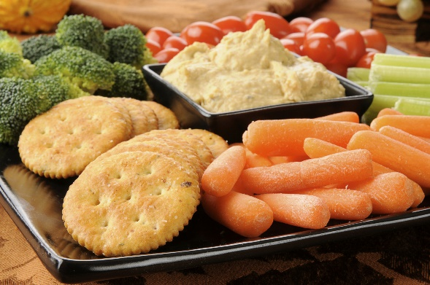

Parent Pay
  We are a cashless school – you will be provided with a log in for Parent Pay once your child starts school
  Pay for trips, events and snack
  Snack:
    Pay £20 termly
    Free fruit is provided
    Milk is available via Cool Milk scheme (free for under 5’s)

Slide 8
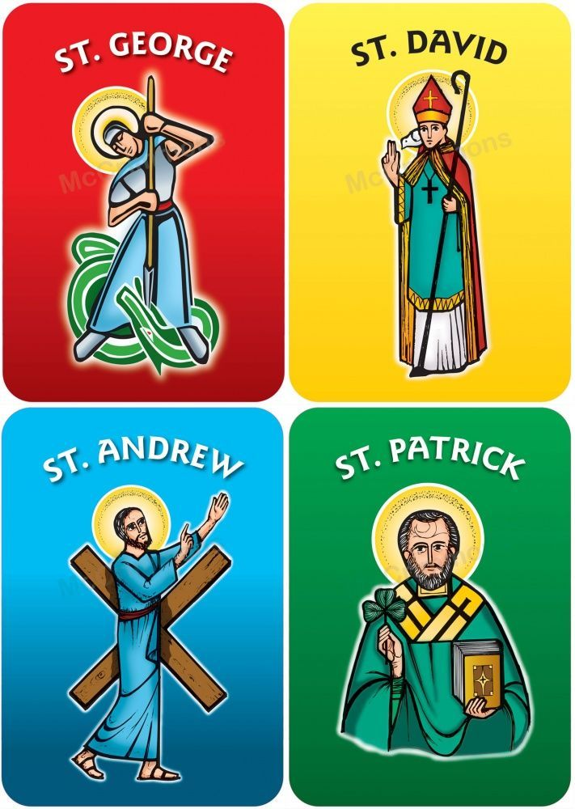
Abacus House Teams
Siblings will be in the same houses.
The children are then split to ensure a balance of boys/girls across the houses.

Slide 9

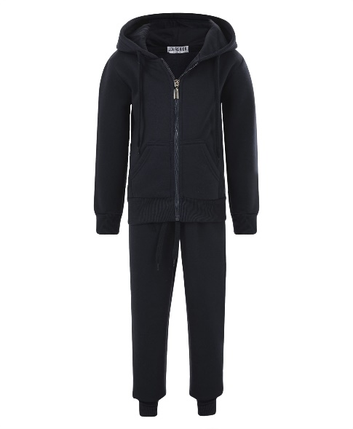
P.E
PE kit –
  House colour top
  Black shorts
  Black trainers
  Plain black tracksuit
No earrings anyway as per EYFS Policy

Slide 10





Communication
  Home school diary (also to be used as your child’s reading journal)
  Tapestry – use the like button!
  At the door – appointment for lengthy chats please
  Text system – you can reply to school texts
  Weekly Newsletter online
  Website – dates, letters, newsletters, class pages
  School Facebook page
  Parent consultations
  End of Year Report

Slide 11
Uniform Expectations
Suppliers: Emblem My Clothing
Yellow polo shirt
Grey trousers/shorts/skirt/dress
Yellow/purple gingham summer dress
Black shoes – no trainers and no laces
White, grey or black socks
Please ensure all items are named (including shoes!)
Please remember coats/jackets– we do go out to play even if it is raining
We have a wellie rack outside as we do go out in the rain (optional)
Long hair always tied up
No nail varnish
No earrings permitted
Water bottle every day please – School policy is that the children are only allowed water in their bottle, not juice
School book bags – don’t have the space for rucksacks, book bags only please (labelled)

Slide 12
Classes and Transition
Tuesday 18th June - Stay and Play –- 3.45pm to 4.30pm:
An informal play session on our astro to start to make some new friends and connect with other parents. (Siblings welcome)
Wednesday 19th June – Stay and Play–- 9.15am to 9.45am:
Parents drop children off for a tour of the Foundation classrooms, a few games and a story with the Foundation team (children only)
Friday 21st June - Classes allocated – you will receive a text
Pink or Blue?
Boys/girls
Age – term of birth
Advice from Preschools/Nurseries
Sibling at Abacus
Thursday 27th June (uniform not needed, do not need to bring anything with them)
Two sessions – 15 children in each
  Morning – 9.00am to 11.00am
  Afternoon – 1.00pm to 3.00pm
Friday 28th June
One session – all children
  9.30am to 11.30am
If your child cannot attend either of these days unfortunately we cannot offer an alternative due to transitions being set to coincide with secondary school dates.
A message will go on Tapestry to let you know if your child will be invited to attend the morning or afternoon session

Slide 13

Home Visits
Will take place in September on:
Thursday 5th
Friday 6th
Monday 9th
Tuesday 10th
Thursday 12th
Time slots are between 9.00am and 12.00pm only. A date/time will be text to you. Please reply via text if you can’t make your allocated slot and we will do our best to fit you in at another time
**The children’s first day of school is Friday 13th September – 9.15am to 3.15pm**
Monday 16th September onwards will be 8.45 to 3.15

Slide 14
See you on Tuesday 18th June ☺

