Slide 1
Spelling Rule
W/C 01/06/2002
Words ending with an /zher/ sound spelt with ‘sure’

Slide 2
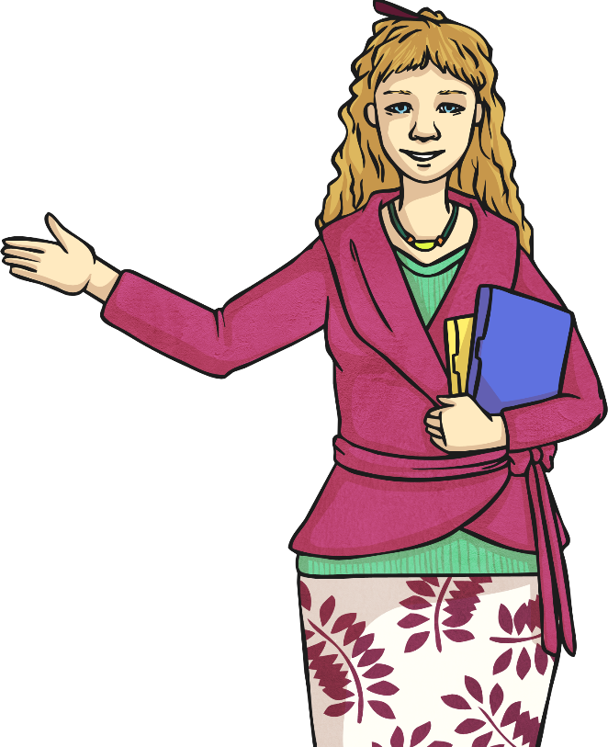
This week, we are looking at words that end with a complicated sound.
treasure
measure
pleasure
enclosure
closure
leisure
exposure
pressure
composure
fissure
Look at all these words. Say them out loud to your friend. Listen carefully to the sound in the final syllable. Repeat the sound the letters ‘sure’ make.
The sound that ‘sure’ makes is /zhuh/.

Slide 3
Activity 1

Slide 4
Help Mr Whoops get across to the right side of this river. Click on the stepping stones in the right order to spell one of this week’s statutory spelling challenge words. Beat the timer or Mr Whoops will end up in the rapids! The first letter will be given to you. If you guess an incorrect letter, a message will pop up which will cost you a five second time penalty! Use the clue to help you.
Example:
Clue: Something that is in high demand.
a
m
l
a
a
r
o
u
u
r
i
d
p
i
p
o
n
o
n
s
k
e
l
e
p

Slide 5
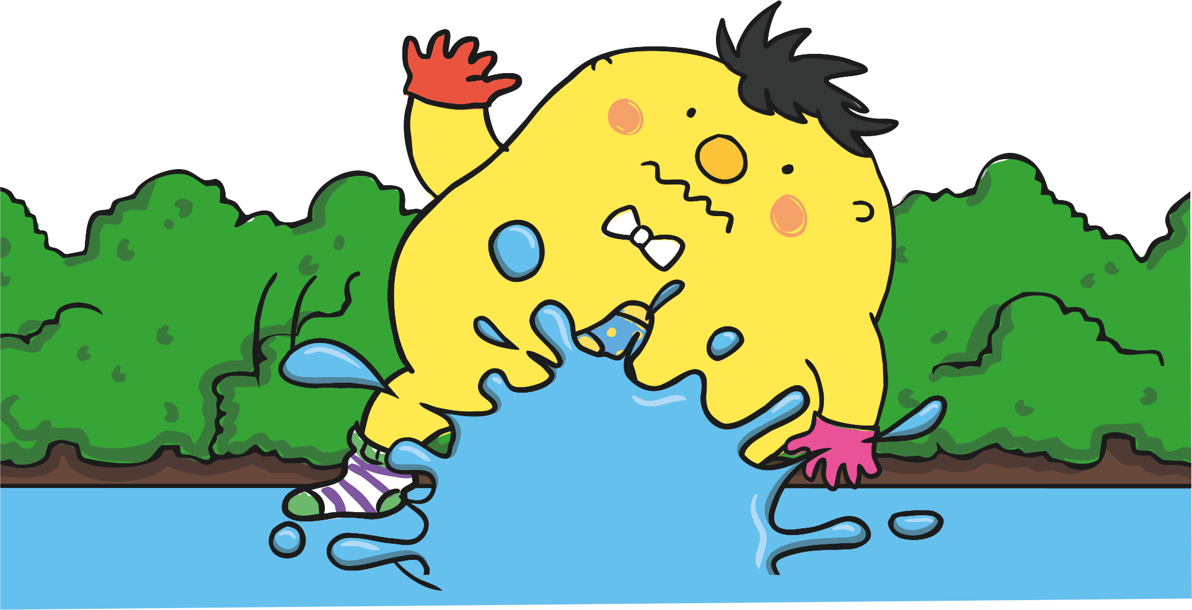
Start
1:00
1:00
0:59
0:58
0:57
0:56
0:55
0:54
0:53
0:52
0:51
0:50
0:49
0:48
0:47
0:46
0:45
0:44
0:43
0:42
0:41
0:40
0:39
0:38
0:37
0:36
0:35
0:34
0:33
0:32
0:31
0:30
0:29
0:28
0:27
0:26
0:25
0:24
0:23
0:22
0:21
0:20
0:19
0:18
0:17
0:16
0:15
0:14
0:13
0:12
0:11
0:10
0:09
0:08
0:07
0:06
0:05
0:04
0:03
0:02
0:01
Time’s up!
Clue: often looked for in quests and adventure stories.
Sorry! You have run out of time and Mr Whoops has slipped and fallen into the rapids!
The word was treasure!
Congratulations, you spelt the word correctly and helped Mr Whoops cross to the other side of the river safely!
Continue
Continue
Incorrect Letter!
Please wait five seconds
r
i
m
s
z
r
a
treasure
j
u
s
o
r
l
i
t
o
e
a
e
p
o
e
i
a
t
n
u
v
h

Slide 6
Start
1:00
1:00
0:59
0:58
0:57
0:56
0:55
0:54
0:53
0:52
0:51
0:50
0:49
0:48
0:47
0:46
0:45
0:44
0:43
0:42
0:41
0:40
0:39
0:38
0:37
0:36
0:35
0:34
0:33
0:32
0:31
0:30
0:29
0:28
0:27
0:26
0:25
0:24
0:23
0:22
0:21
0:20
0:19
0:18
0:17
0:16
0:15
0:14
0:13
0:12
0:11
0:10
0:09
0:08
0:07
0:06
0:05
0:04
0:03
0:02
0:01
Clue: to discover the exact size of something.
Time’s up!
Sorry! You have run out of time and Mr Whoops has slipped and fallen into the rapids!
The word was measure!
Congratulations, you spelt the word correctly and helped Mr Whoops cross to the other side of the river safely!
Continue
Continue
Incorrect Letter!
Please wait five seconds
a
h
y
l
f
o
measure
e
f
t
o
w
l
m
y
e
s
e
r
e
i
a
e
u
e
f

Slide 7
Start
1:00
1:00
0:59
0:58
0:57
0:56
0:55
0:54
0:53
0:52
0:51
0:50
0:49
0:48
0:47
0:46
0:45
0:44
0:43
0:42
0:41
0:40
0:39
0:38
0:37
0:36
0:35
0:34
0:33
0:32
0:31
0:30
0:29
0:28
0:27
0:26
0:25
0:24
0:23
0:22
0:21
0:20
0:19
0:18
0:17
0:16
0:15
0:14
0:13
0:12
0:11
0:10
0:09
0:08
0:07
0:06
0:05
0:04
0:03
0:02
0:01
Time’s up!
Clue: a pleasant or happy feeling.
Sorry! You have run out of time and Mr Whoops has slipped and fallen into the rapids!
The word was pleasure!
Congratulations, you spelt the word correctly and helped Mr Whoops cross to the other side of the river safely!
Continue
Continue
Incorrect Letter!
Please wait five seconds
o
e
m
o
z
r
a
pleasure
j
u
s
s
r
l
f
p
l
i
a
e
p
o
e
i
a
t
n
u
v
h

Slide 8
Clue: an area that has a barrier of some sort, often for animals.
Start
1:00
1:00
0:59
0:58
0:57
0:56
0:55
0:54
0:53
0:52
0:51
0:50
0:49
0:48
0:47
0:46
0:45
0:44
0:43
0:42
0:41
0:40
0:39
0:38
0:37
0:36
0:35
0:34
0:33
0:32
0:31
0:30
0:29
0:28
0:27
0:26
0:25
0:24
0:23
0:22
0:21
0:20
0:19
0:18
0:17
0:16
0:15
0:14
0:13
0:12
0:11
0:10
0:09
0:08
0:07
0:06
0:05
0:04
0:03
0:02
0:01
Time’s up!
Sorry! You have run out of time and Mr Whoops has slipped and fallen into the rapids!
The word was enclosure!
Congratulations, you spelt the word correctly and helped Mr Whoops cross to the other side of the river safely!
Continue
Continue
Incorrect Letter!
Please wait five seconds
e
w
z
u
z
e
enclosure
o
m
a
f
s
o
r
l
r
n
e
n
y
l
e
v
o
a
u
i
c
x
c
s
y
h
z

Slide 9
Start
1:00
1:00
0:59
0:58
0:57
0:56
0:55
0:54
0:53
0:52
0:51
0:50
0:49
0:48
0:47
0:46
0:45
0:44
0:43
0:42
0:41
0:40
0:39
0:38
0:37
0:36
0:35
0:34
0:33
0:32
0:31
0:30
0:29
0:28
0:27
0:26
0:25
0:24
0:23
0:22
0:21
0:20
0:19
0:18
0:17
0:16
0:15
0:14
0:13
0:12
0:11
0:10
0:09
0:08
0:07
0:06
0:05
0:04
0:03
0:02
0:01
Clue: to bring something to an end.
Time’s up!
Sorry! You have run out of time and Mr Whoops has slipped and fallen into the rapids!
The word was closure!
Congratulations, you spelt the word correctly and helped Mr Whoops cross to the other side of the river safely!
Continue
Continue
Incorrect Letter!
Please wait five seconds
e
h
y
l
f
o
closure
l
f
t
o
u
l
c
y
a
s
e
r
e
i
o
e
u
e
f

Slide 10
Start
1:00
1:00
0:59
0:58
0:57
0:56
0:55
0:54
0:53
0:52
0:51
0:50
0:49
0:48
0:47
0:46
0:45
0:44
0:43
0:42
0:41
0:40
0:39
0:38
0:37
0:36
0:35
0:34
0:33
0:32
0:31
0:30
0:29
0:28
0:27
0:26
0:25
0:24
0:23
0:22
0:21
0:20
0:19
0:18
0:17
0:16
0:15
0:14
0:13
0:12
0:11
0:10
0:09
0:08
0:07
0:06
0:05
0:04
0:03
0:02
0:01
Clue: the time when you are not at work or school.
Time’s up!
Sorry! You have run out of time and Mr Whoops has slipped and fallen into the rapids!
The word was leisure!
Congratulations, you spelt the word correctly and helped Mr Whoops cross to the other side of the river safely!
Continue
Continue
Incorrect Letter!
Please wait five seconds
e
h
y
u
f
o
leisure
y
f
s
o
r
e
l
e
i
t
e
r
l
i
a
e
l
e
f

Slide 11
Clue: the state of having no protection against or cover from.
Start
1:00
1:00
0:59
0:58
0:57
0:56
0:55
0:54
0:53
0:52
0:51
0:50
0:49
0:48
0:47
0:46
0:45
0:44
0:43
0:42
0:41
0:40
0:39
0:38
0:37
0:36
0:35
0:34
0:33
0:32
0:31
0:30
0:29
0:28
0:27
0:26
0:25
0:24
0:23
0:22
0:21
0:20
0:19
0:18
0:17
0:16
0:15
0:14
0:13
0:12
0:11
0:10
0:09
0:08
0:07
0:06
0:05
0:04
0:03
0:02
0:01
Time’s up!
Sorry! You have run out of time and Mr Whoops has slipped and fallen into the rapids!
The word was exposure!
Congratulations, you spelt the word correctly and helped Mr Whoops cross to the other side of the river safely!
Continue
Continue
Incorrect Letter!
Please wait five seconds
i
i
m
s
z
l
a
exposure
j
u
o
o
r
r
u
e
o
a
s
e
u
o
h
x
p
t
n
p
v
e

Slide 12
Start
1:00
1:00
0:59
0:58
0:57
0:56
0:55
0:54
0:53
0:52
0:51
0:50
0:49
0:48
0:47
0:46
0:45
0:44
0:43
0:42
0:41
0:40
0:39
0:38
0:37
0:36
0:35
0:34
0:33
0:32
0:31
0:30
0:29
0:28
0:27
0:26
0:25
0:24
0:23
0:22
0:21
0:20
0:19
0:18
0:17
0:16
0:15
0:14
0:13
0:12
0:11
0:10
0:09
0:08
0:07
0:06
0:05
0:04
0:03
0:02
0:01
Time’s up!
Clue: the force you make when you press something.
Sorry! You have run out of time and Mr Whoops has slipped and fallen into the rapids!
The word was pressure!
Congratulations, you spelt the word correctly and helped Mr Whoops cross to the other side of the river safely!
Continue
Continue
Incorrect Letter!
Please wait five seconds
o
i
m
o
z
r
a
pressure
j
e
z
s
r
l
i
p
r
u
s
z
e
o
e
i
a
t
n
u
v
h

Slide 13
Start
1:00
1:00
0:59
0:58
0:57
0:56
0:55
0:54
0:53
0:52
0:51
0:50
0:49
0:48
0:47
0:46
0:45
0:44
0:43
0:42
0:41
0:40
0:39
0:38
0:37
0:36
0:35
0:34
0:33
0:32
0:31
0:30
0:29
0:28
0:27
0:26
0:25
0:24
0:23
0:22
0:21
0:20
0:19
0:18
0:17
0:16
0:15
0:14
0:13
0:12
0:11
0:10
0:09
0:08
0:07
0:06
0:05
0:04
0:03
0:02
0:01
Clue: a feeling of calm and quiet.
Time’s up!
Sorry! You have run out of time and Mr Whoops has slipped and fallen into the rapids!
The word was composure!
Congratulations, you spelt the word correctly and helped Mr Whoops cross to the other side of the river safely!
Continue
Continue
Incorrect Letter!
Please wait five seconds
e
u
z
u
z
e
composure
o
m
a
m
s
o
r
l
h
n
c
o
y
p
e
v
o
a
u
i
n
x
c
s
y
r
z

Slide 14
Clue: a crack that appears, especially in rock or earth.
Start
1:00
1:00
0:59
0:58
0:57
0:56
0:55
0:54
0:53
0:52
0:51
0:50
0:49
0:48
0:47
0:46
0:45
0:44
0:43
0:42
0:41
0:40
0:39
0:38
0:37
0:36
0:35
0:34
0:33
0:32
0:31
0:30
0:29
0:28
0:27
0:26
0:25
0:24
0:23
0:22
0:21
0:20
0:19
0:18
0:17
0:16
0:15
0:14
0:13
0:12
0:11
0:10
0:09
0:08
0:07
0:06
0:05
0:04
0:03
0:02
0:01
Time’s up!
Sorry! You have run out of time and Mr Whoops has slipped and fallen into the rapids!
The word was fissure!
Congratulations, you spelt the word correctly and helped Mr Whoops cross to the other side of the river safely!
Continue
Continue
Incorrect Letter!
Please wait five seconds
e
h
y
l
f
e
fissure
i
f
h
o
r
l
f
y
s
e
u
y
o
u
a
s
e
e
f

Slide 15
Activity 2

Slide 16
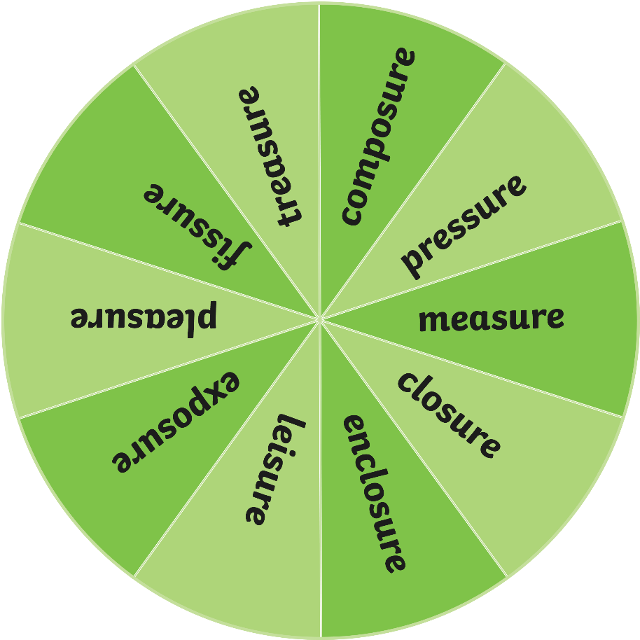
Spin the spinner to pick a word from this week’s spelling list. Follow each of the three instructions for each word you land on.
Speed write the word you have landed on for one minute.
1
Act out the meaning of the word to your friend.
2
Draw a picture to represent the word.
3
Spin

Slide 17
Activity 3

Slide 19
Activity 4

Slide 21
Activity 5
Spelling Test
or
Look Cover Write

Slide 22
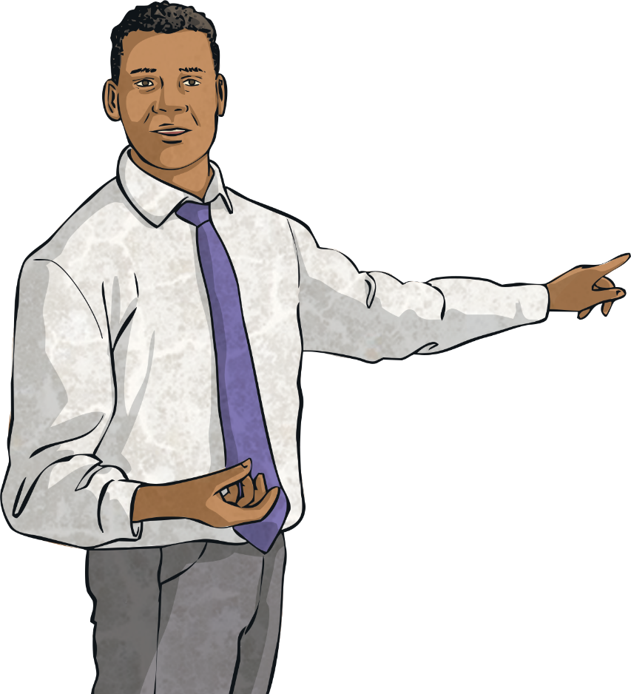
Here are your spelling words for this week.
treasure
measure
pleasure
enclosure
closure
leisure
exposure
pressure
composure
fissure

